Slide 1

EShoppingZone
Created By
Anu Singh
Swayam Prakash Bhuyan
Praneender
Tanugula Akhila
Mohammed Talib
Vidyashree P
Sivaprasad nelli
Palagiri Rajiya
Prasid Satish Chinchakar
Ganesh Sivarathri
Jubeda Begum

Slide 2

Specifications and other Technologies used
This Project was aimed at developing a Online Shopping System.
For Frontend we are using:-
ReactJs
TypeScript
HTML5
CSS3
For Backend we are using:-
ASP.NET Core web api
Entity Framework
Swagger

Slide 3
Functionality Of Customer
1. Customers can create account through Registration.
2. login to their active account .
3. Users or Customers can browse various types of products in Catalog Page.
4. View the details of products.
5. Add products into Cart.
6. Add more items into Carts.
7. Delete items from Carts and can be Update.
9. Customers can Checkout their Order, Order details, Edit Address and Update.
10. Payment Option.
8. Order Placed.
9. Customer can view Order Summary.
10. About Our Online Shopping application.

Slide 4
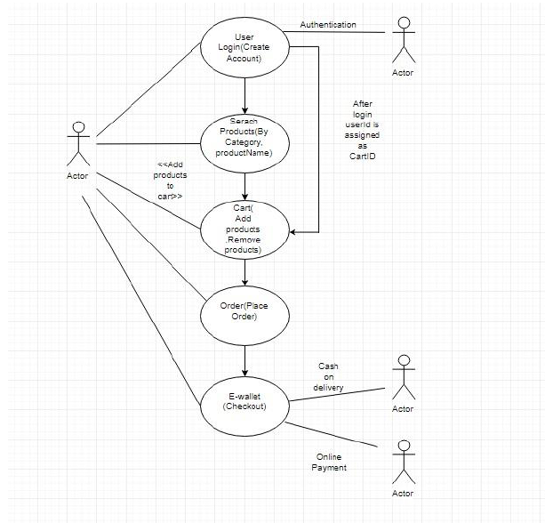
UML Diagram

Slide 5
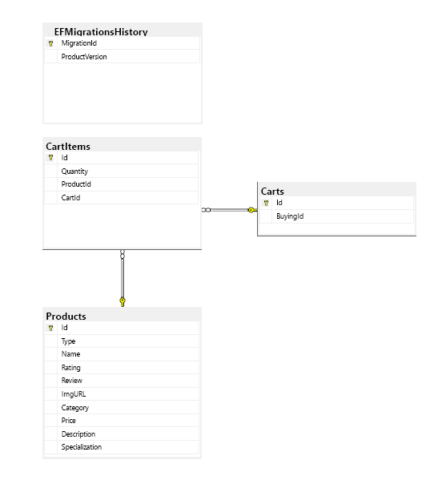
ERD Diagram

Slide 6
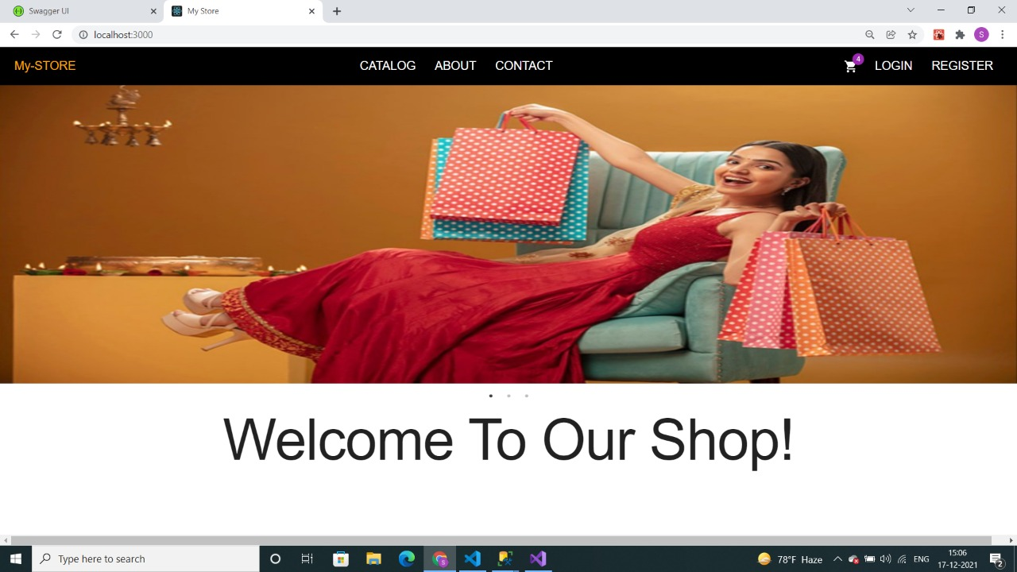
Home Page

Slide 7
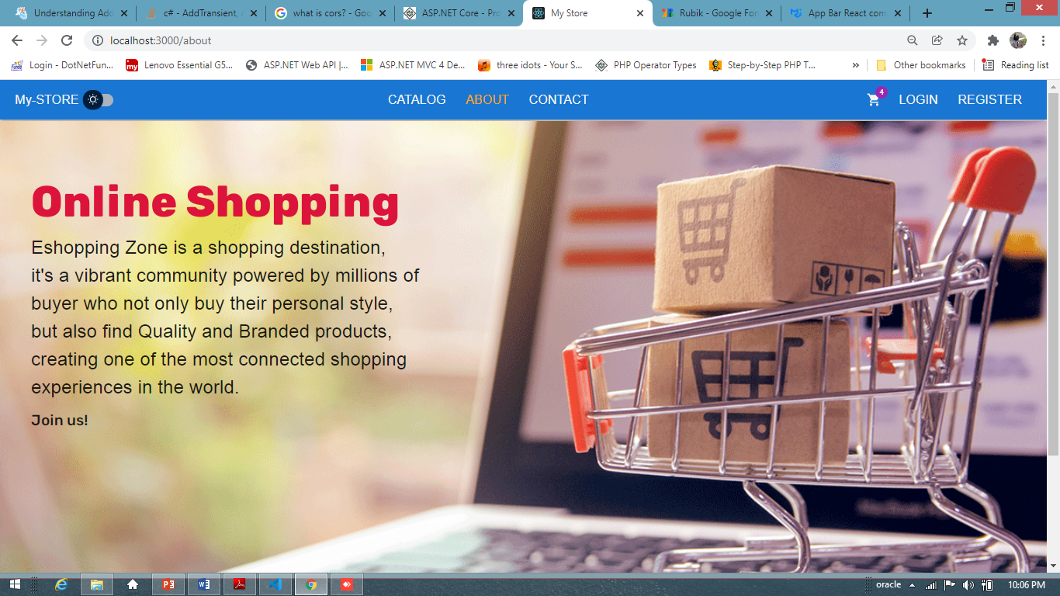
About Us Page

Slide 8
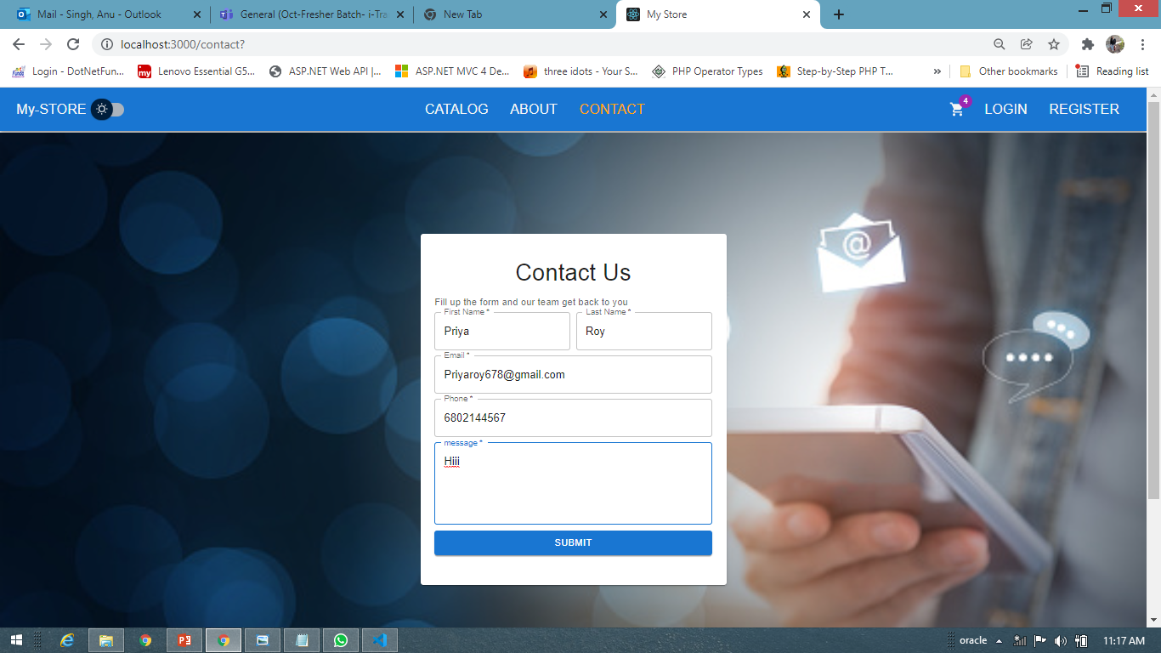
Contact Us

Slide 9
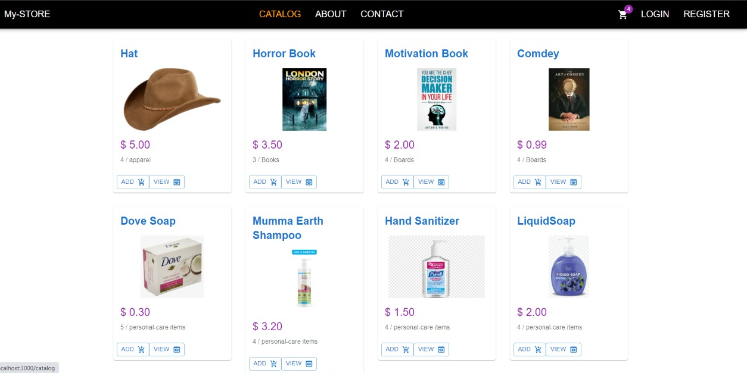
Catalog

Slide 10
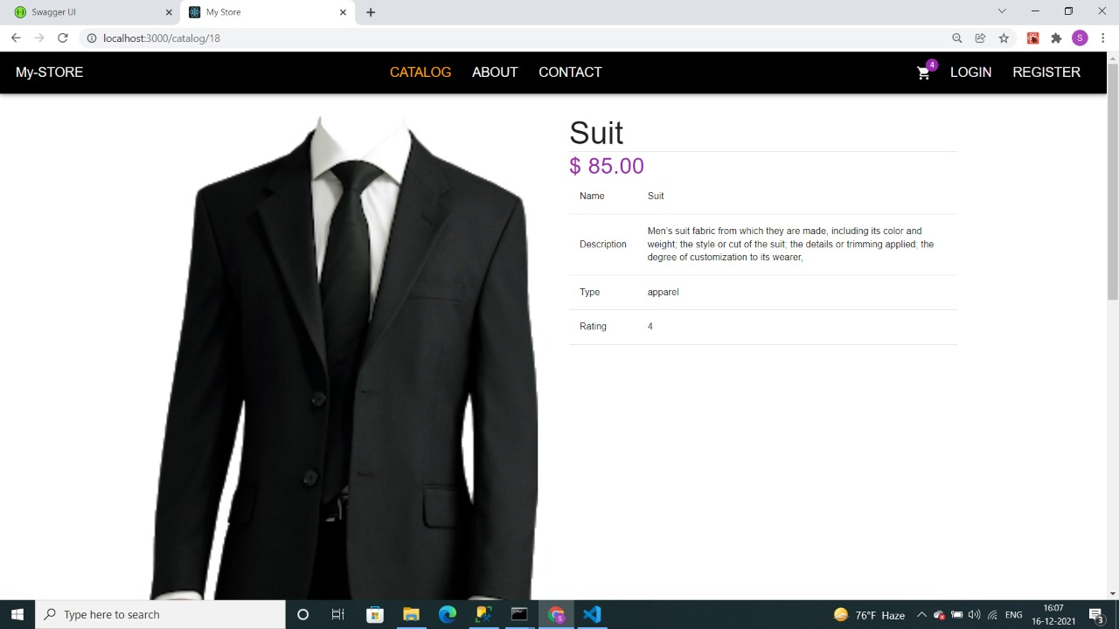
View Products

Slide 11
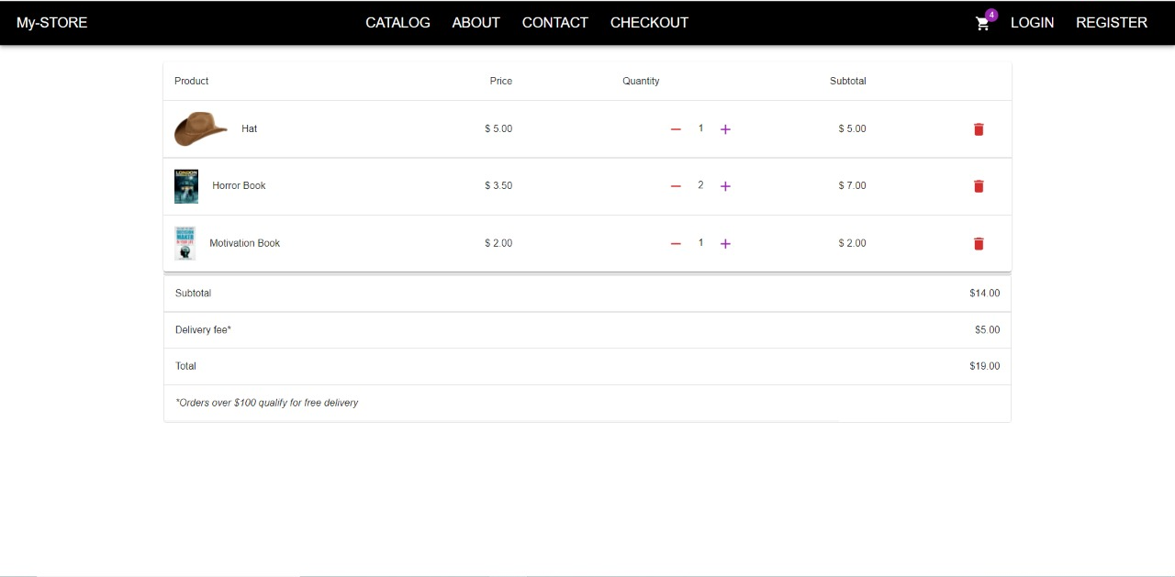
Products Add Into Cart

Slide 12
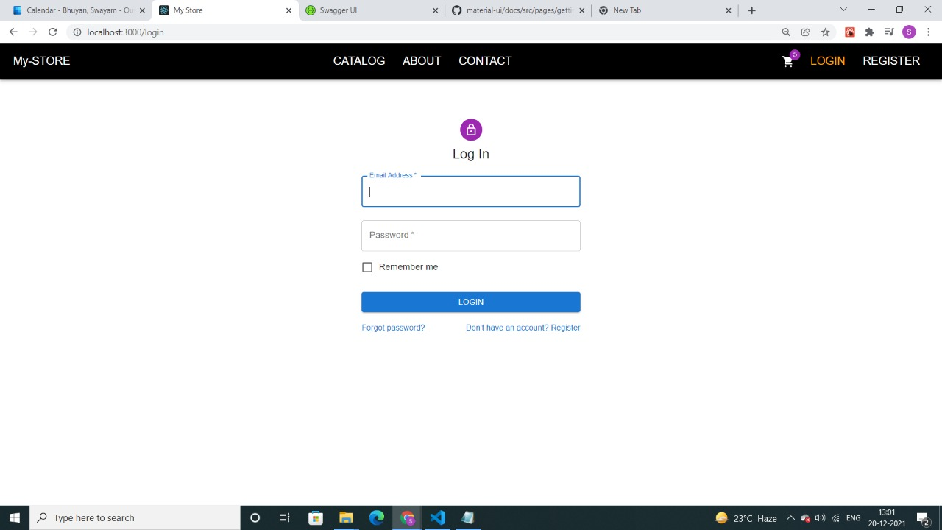
Login page

Slide 13
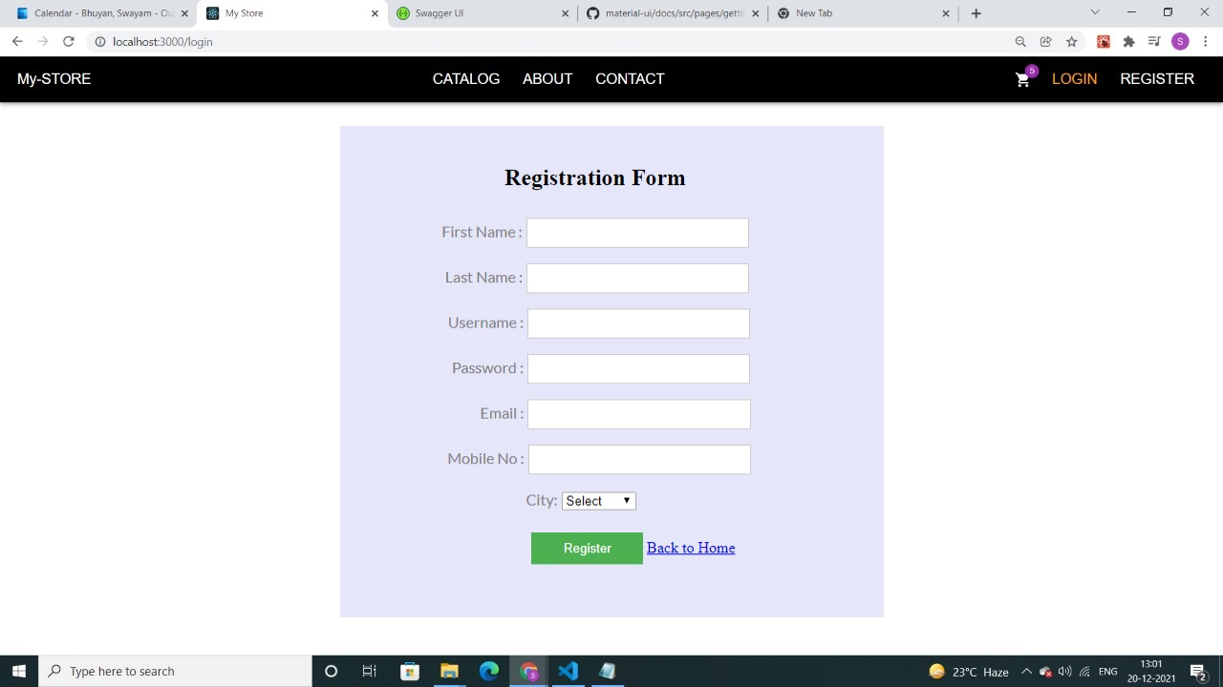
Login page

Slide 14
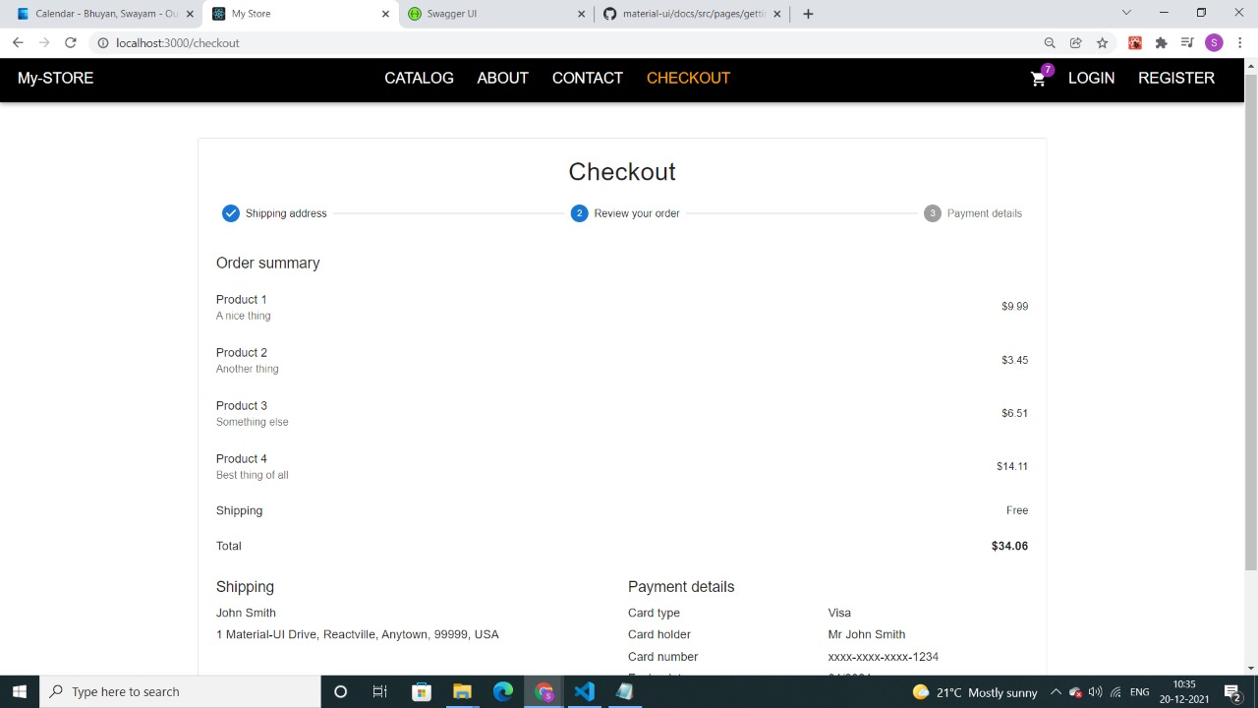
Order Summary

Slide 15
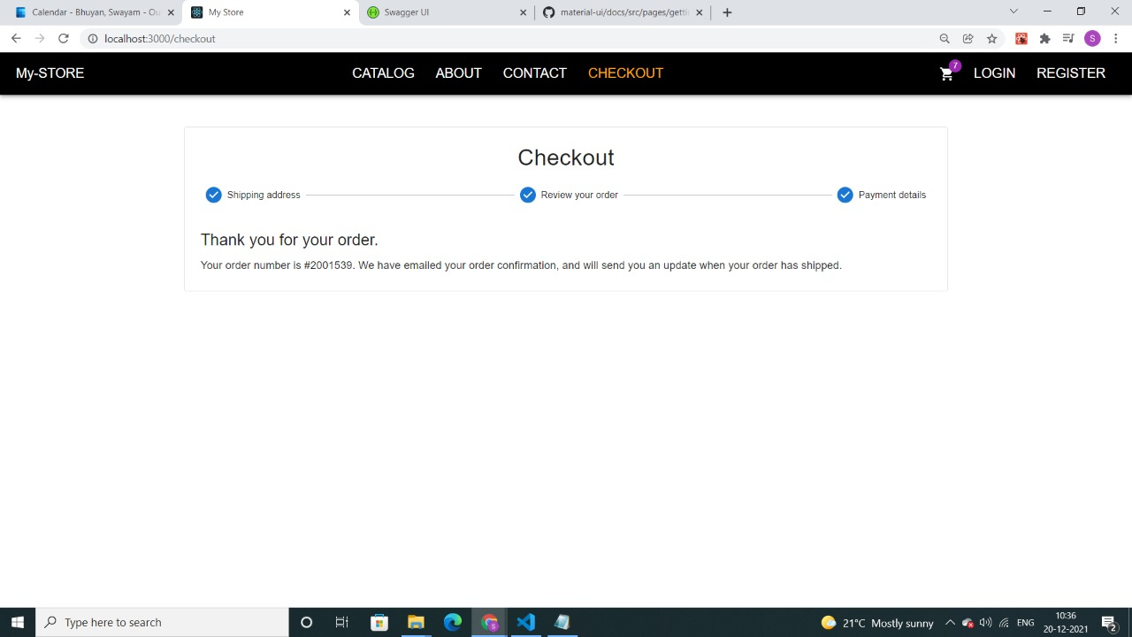
Checkout Page (Check Your Order)

Slide 16


